Slide 1

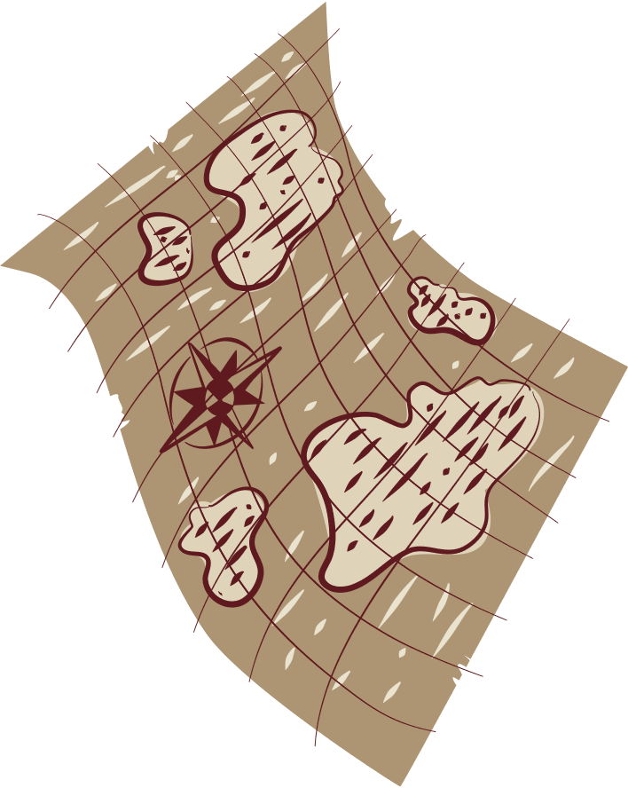

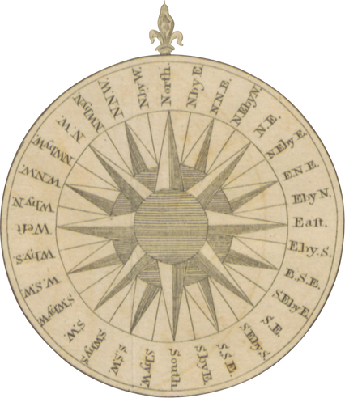

NCERT
FeedBack
For primary school students

Slide 2
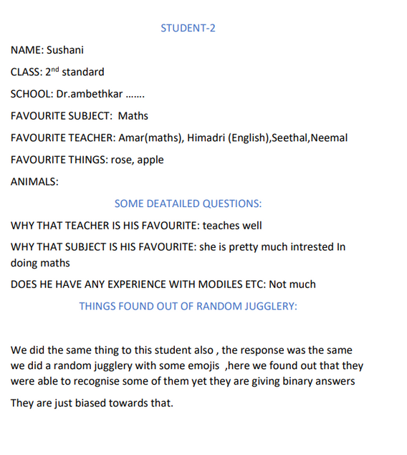
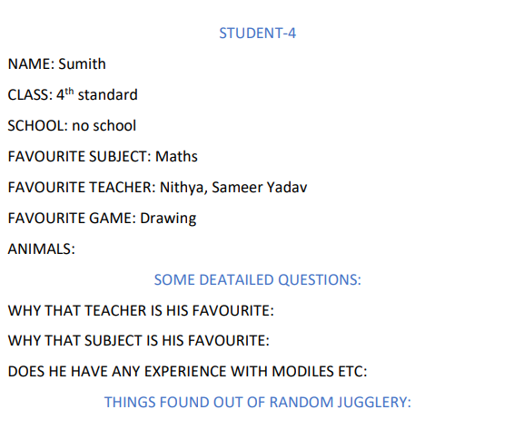
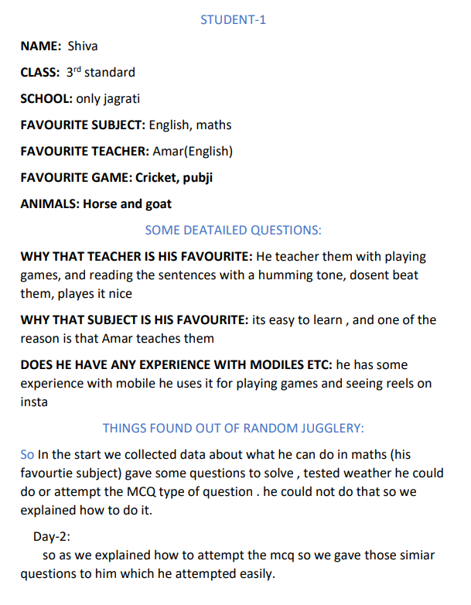

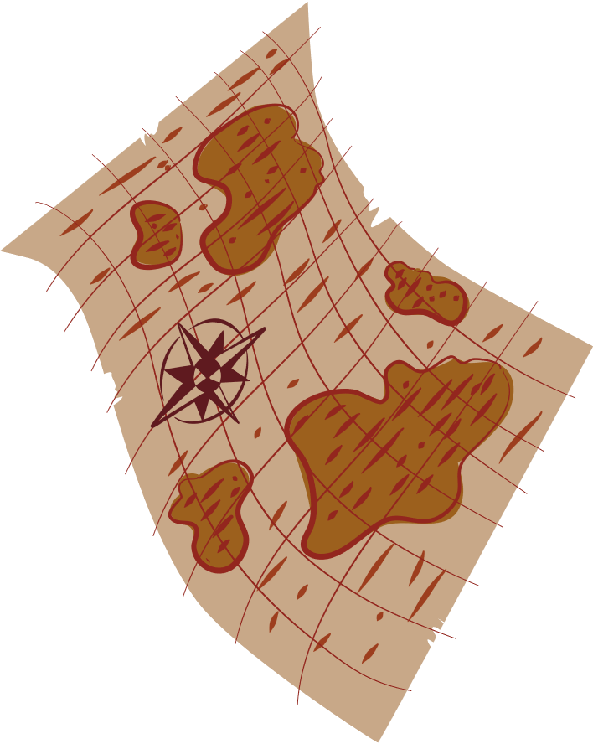
UserStudy

Slide 3

For primary students
Traditional feedback system for the students involves some questions about the teacher and subject which the student needs to answer
This project involves interaction with the primary students who generally lack in perception and decision making abilites

Slide 4
TASK | KNOWLEDGE | FEEDBACK | POTENTIAL PROBLEM | DESIGN DETAIL
to on the device | Know the placement of button | Auditary Haptic | Comfusion with other buttons | Make it esily accesible and indentifiable
understanding the given question | Able to read the text | None | Not able understand questions | Constructing questions as simple as possible
Answering the questions | Identify where to answer the question | Auditory Haptic Visible | Not able to identify where to answer | Giving direction how to answer
Moving on to next quesion | Knowing how to submit and move to the next question | Visible | Not knowing how to go further | Giving the Directions
Operating the functional button | Knowing the placement and purpose of buttons | Haptic Auditary visual | May confuse between buttons | Making each button unique and differ

Slide 5

Problems/opportunities
Reading the question.
Correct Perception of the question or understanding
Giving the correct answer (getting the influenced by the environment)
Not Being able to answer different kinds of questions new to them

Slide 6




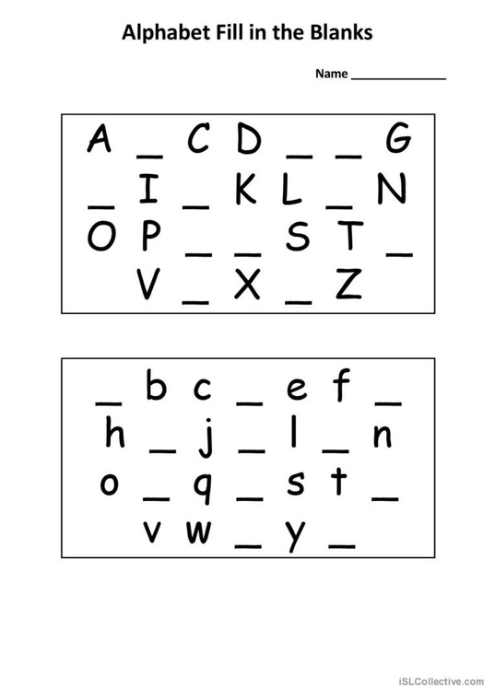
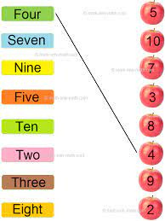
Types of Questions they are familiar
Descriptive
Fill in the blanks
Match the following
questions and answers are in descriptive
to fill the blank with the correct word
to map things which connect

Slide 7
Students are getting bored easily , so we need to make things interesting , so called wow factor
Students should not feel it like a test , which creates a sense of fear in them
where as we come to the , grouping or isolation of students in grouping the answers are getting biased

Slide 8


What made them intresting
Asking the questions in a contradictory way to grab the attention of the students
Giving breaks in the middle of the process to make them feel relaxed
Asking or reading the questions with a humming sound
Making the stroy telling as a part of the question

Slide 9
Thank You for listening!

